Slide 1
Team Nostos
Bradley boutcher and christine frandsen

Slide 2
Our Project
Worked with the Department of New Urban Mechanics
Primary contacts were Kim Lucas and Kelly Mackey
Designed a prototype to rework the current moving truck permitting system

Slide 3
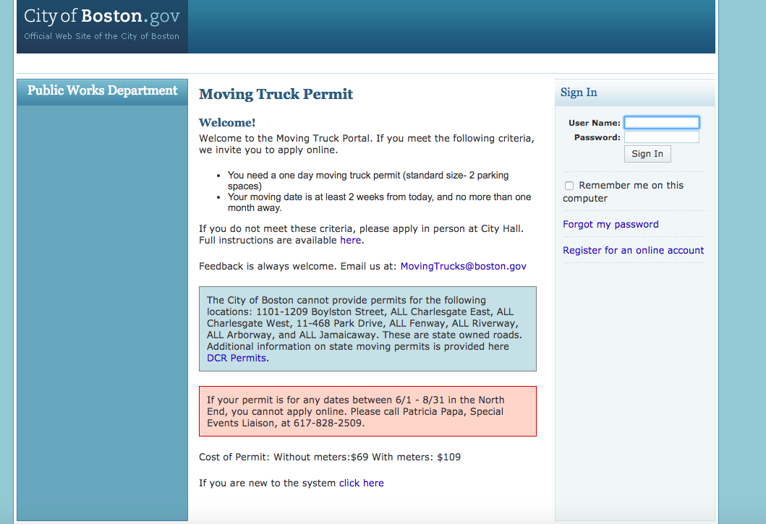
Current Permit System

Slide 4
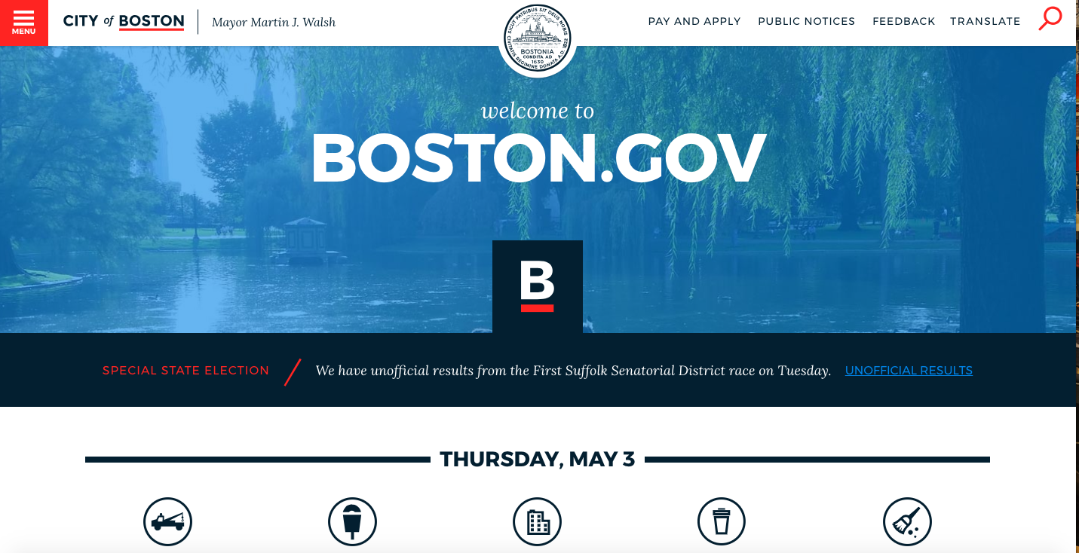
Boston.gov Home Page

Slide 5
Our Process

Slide 6
Structure of the Project
Moving Truck Permit Portal
Client
Server

Slide 7
Client
Client
Actions
Reducers
Components
Containers
Middleware
Forms
Common
Maps

Slide 8
Server
Server
Models
Controllers
Middleware
Routes
Services

Slide 9
Database Schema

